Slide 1
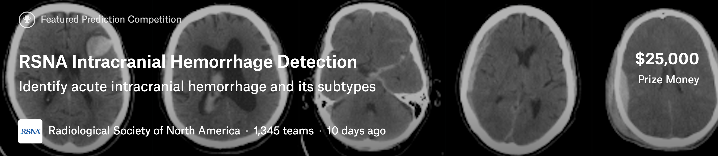
Winner presentation – 2nd Place Solution
Darragh Hanley, Dmitry Larko
Nov 2019

Slide 2
Team
Dmitry Larko is a Senior Data Scientist who works on automatization of machine learning tasks (AutoML). Dmitry has a wide expertise in classical ML and Deep Learning.
Darragh Hanley is an AI engineer at Optum focused on deep learning to improve health outcomes. He also lectures at Berkeley MIDS program.

Slide 3
Components of proposed solution
Windowing
Cropping and augmentation
Image Classification
GAP Layer Extraction
Sequential Modelling
Bagging
Hardware :
Ubuntu 16.04 LTS (512 GB boot disk) Single Node of 4 x NVIDIA Tesla V100 16 GB memory per GPU 4x 1.92 TB SSD RAID 0 Dual 20-core Intel® Xeon® E5-2698 v4 2.2 GHz
Software :
Pytorch, Python, Docker, Albumentations, pretrainedmodels, Scikit-learn

Slide 4
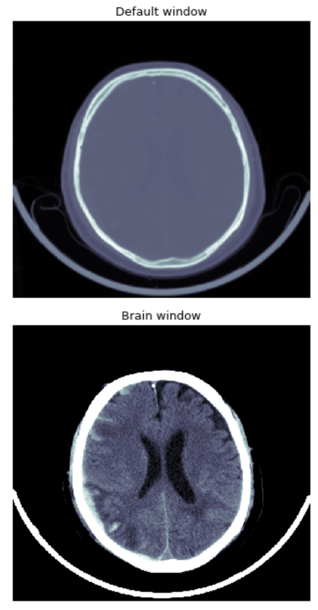
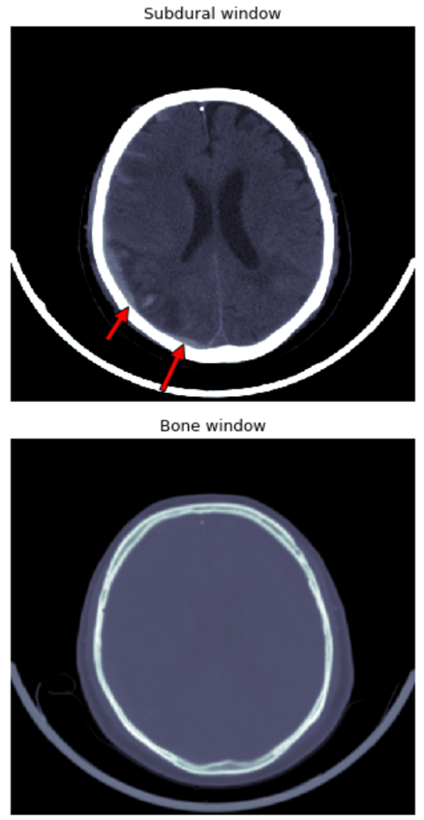
Components of proposed solution
There are at least 5 windows that a radiologist goes through for each scan.
Brain Matter window : W:80 L:40
Blood/subdural window: W:130-300 L:50-100
Soft tissue window: W:350–400 L:20–60
Bone window: W:2800 L:600
Grey-white differentiation window: W:8 L:32 or W:40 L:40
Windowing
Cropping and augmentation
Image Classification
GAP Layer Extraction
Sequential Modelling
Bagging
Dicom
File
Credits
@DavidTang
@appian

Slide 5
Components of proposed solution
Used the albumentations library
Crop all black areas, keep aspect ratio.
We performed the following augmentations,
HorizontalFlip
ShiftScaleRotate
Transpose
Normalise
mean_img = [0.2236, 0.1819, 0.2523]
std_img = [0.3245, 0.2956, 0.3133]
Windowing
Cropping and augmentation
Image Classification
GAP Layer Extraction
Sequential Modelling
Bagging

Slide 6
Components of proposed solution
Exploring the Limits of Weakly Supervised Pretraining,
Dhruv Mahajan and Ross Girshick and Vignesh Ramanathan and Kaiming He and Manohar Paluri and Yixuan Li and Ashwin Bharambe and Laurens van der Maaten, 2018,
1805.00932,arXiv
Windowing
Cropping and augmentation
Image Classification
GAP Layer Extraction
Sequential Modelling
Bagging
Credits
@facebookresearch

Slide 7
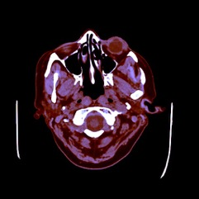
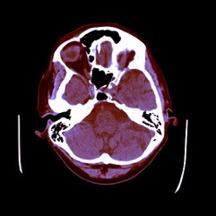
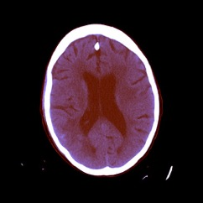
Components of proposed solution
Time
Clinical Diagnosis
Windowing
Cropping and augmentation
Image Classification
GAP Layer Extraction
Sequential Modelling
Bagging

Slide 8
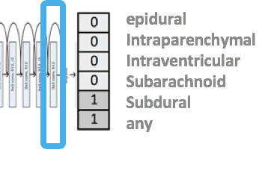
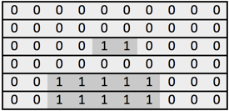
Components of proposed solution
CT Scan Sequence on Patient, Series, Study
Windowing
Cropping and augmentation
Image Classification
GAP Layer Extraction
Sequential Modelling
Bagging
2048 embedding
2048 prev emb-next
2048 next emb-prev
Bi-BLSTM
Dense block 4096 X 4096
Bi-BLSTM
Dense block 4096 X 4096
Sum LSTM & Dense layers & Embedding
Linear layer
epidural
Intraparenchymal
Intraventricular
Subarachnoid
Subdural
any

Slide 9
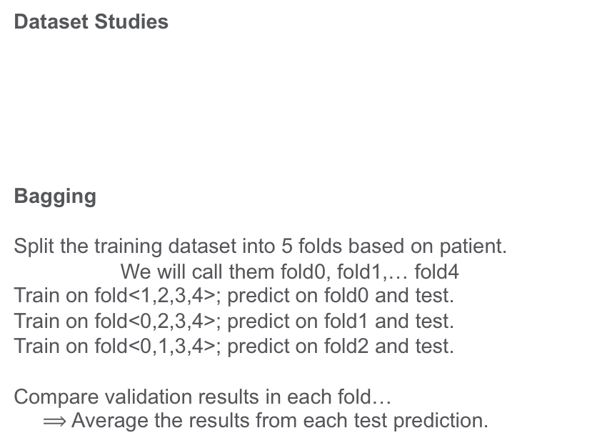
Components of proposed solution
Dataset Studies
Bagging
Split the training dataset into 5 folds based on patient.
We will call them fold0, fold1,… fold4
Train on fold<1,2,3,4>; predict on fold0 and test.
Train on fold<0,2,3,4>; predict on fold1 and test.
Train on fold<0,1,3,4>; predict on fold2 and test.
Compare validation results in each fold…
$⟹$ Average the results from each test prediction.
Windowing
Cropping and augmentation
Image Classification
GAP Layer Extraction
Sequential Modelling
Bagging
 | Train | Test
Condition | 8003 | 872
No condition | 19530 | 2245

Slide 10
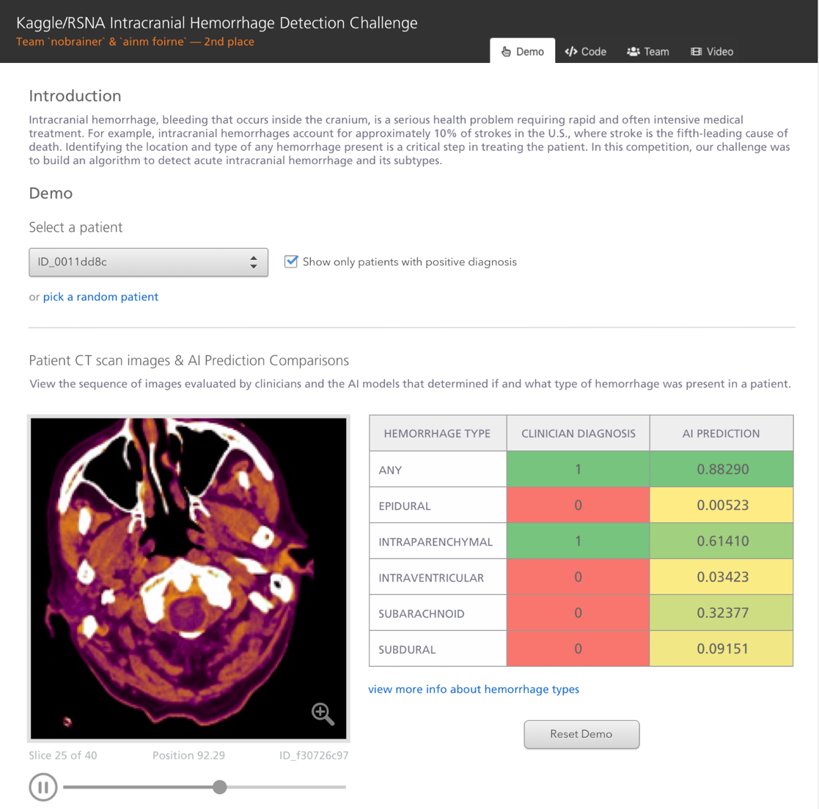
Solution link
Link to repo
Demo
Github : https://github.com/darraghdog/rsna
Competition :
https://www.kaggle.com/c/rsna-intracranial-hemorrhage-detection/overview

Slide 11
Thank you!

Slide 12
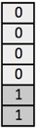
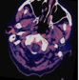
CT Scan Sequence on Patient, Series, Study
Windowing:
> Brain
> Subdural
> Bone
Crop fully black areas, keeping aspect ratio
Augment hflip, vflip, transpose, shiftscale, brightness, resize-480 (albumentations)
Dicom
Files
2048 embedding
Concatenate `current-next` and `current-previous`
Bi-BLSTM
Extract for train and test pre-logit layer of dim 2048 for each epoch with TTA (Original, Hflip, Transpose)
Dense block 4096 X 4096
Bi-BLSTM
epidural
Intraparenchymal
Intraventricular
Subarachnoid
Subdural
any
Dense block 4096 X 4096
Also Sum embedding
Sum LSTM & Dense layers
Linear layer
Classifier :
resnext101_32x8d_wsl
facebookresearch/WSL-Images
epidural
Intraparenchymal
Intraventricular
Subarachnoid
Subdural
any

Slide 13
Differentiators – vs other competitor’s solutions
Benchmark
What we did well:
Removing image artifacts to focus on brain.
No `gut-feel` post processing; feed image model representation to LSTM let DL to decide on DL.
Beefy Image model, Beefy LSTM
What we missed and worked for others:
Much heavier augmentation.
A next stage to LSTM, take all LSTM outputs and feed to meta model.
Different types of windowing.
Many more image models (we only had 1 – but this is expensive).
Diverse image models exposing cuts of slices from images along z-axis

